Slide 1
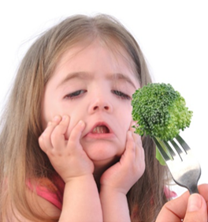
PTC Taster Lab
From Genotype to Phenotype
@miniPCR
fb.com/miniPCR
@miniPCR
© 2019 by Amplyus LLC

Slide 2
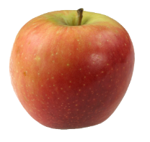
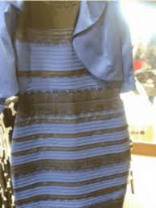
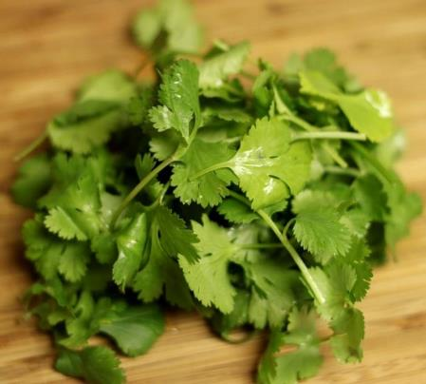
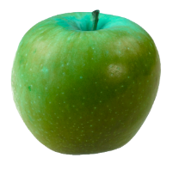
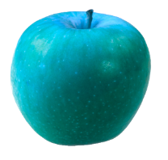
Is your blue my red? (and other deep thoughts)

Slide 3
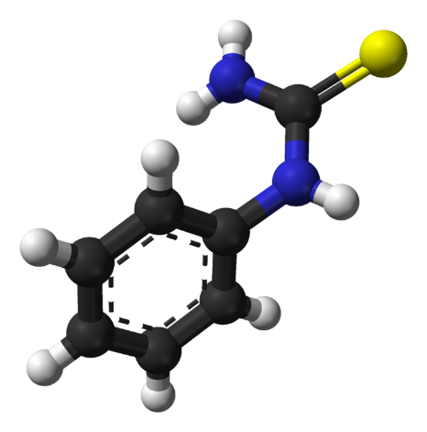
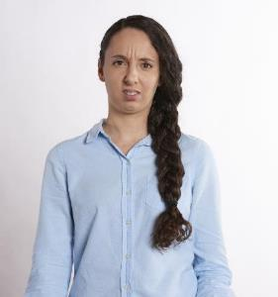
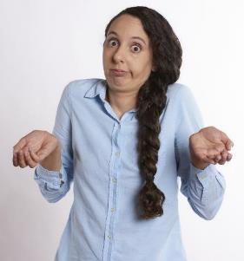
PTC (Phenylthiocarbamide)
Chemical not normally found in foods.
When tasted, elicits one of two responses.

Slide 4
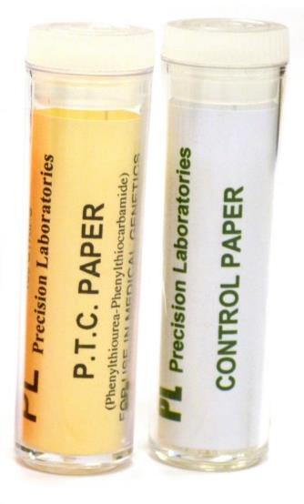
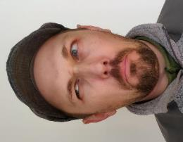
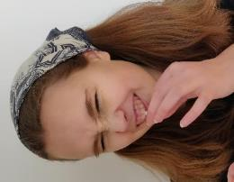
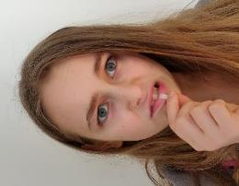
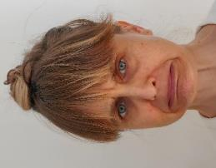
Let’s try it!
Place the paper on the tongue.
Important to use control paper too!
T
T
T
T
Notes:
Uck. It’s not good.

Slide 5
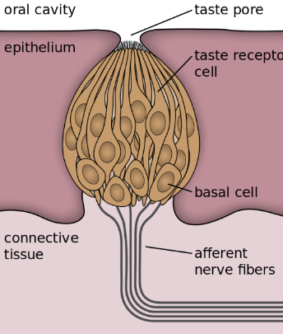
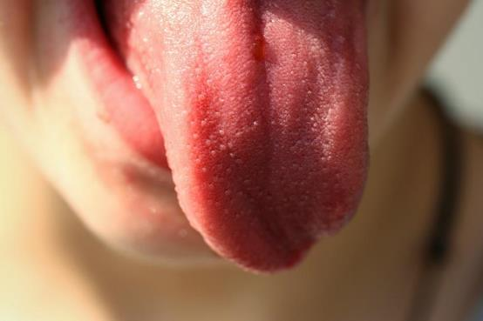
Taste reception
Notes:
Hundreds of papillae
3-5 Buds per papillae – More on back of tongue and side
30-100cells per bud – gustatory cells

Slide 6
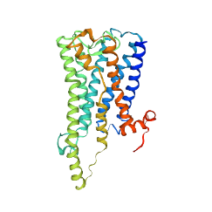
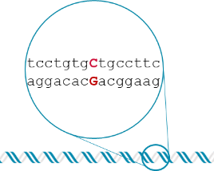
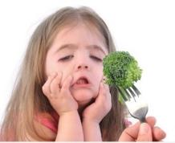
Full picture of genotype to phenotype
TRANSLATION
AAAAAA
TRANSCRIPTION
SIGNAL TRANSDUCTION
‘taster’ mRNA
‘non-taster’ mRNA
‘taster’ protein
‘non-taster’ protein
genotype
phenotype
Notes:
We know my phenotype – Uck
We know what genotypes lead to that.
Very few cases that we can make this complete link.
OVER SIMPLIFYING

Slide 7
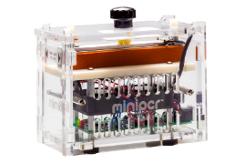
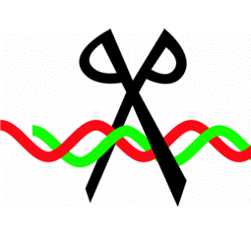
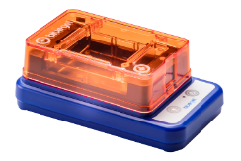
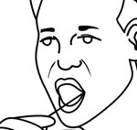

From phenotype to genotype in two class periods
DNA extraction
PCR
Restriction digest
Gel electrophoresis
First class (45 min)
Second class (45 min)

Slide 8
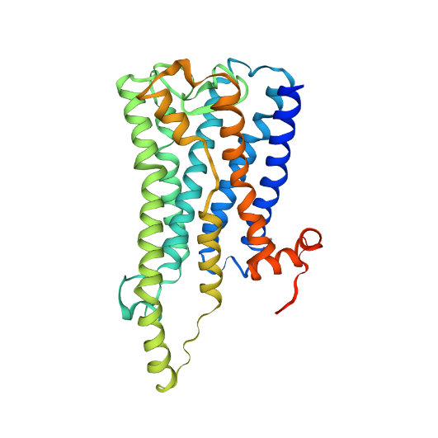
TAS2R38 taste receptor
Bitter taste receptor.
Part of the T2R family of taste receptors.
Like other sweet and bitter taste receptors it is a G-protein coupled receptor.
Outside of cell
Cell membrane
Inside of cell
Model made using Swiss-Model
Waterhouse, A., Bertoni, M., Bienert, S., Studer, G., Tauriello, G., Gumienny, R., Heer, F.T., de Beer, T.A.P., Rempfer, C., Bordoli, L., Lepore, R., Schwede, T. SWISS-MODEL: homology modelling of protein structures and complexes. Nucleic Acids Res. 46, W296-W303 (2018).

Slide 9
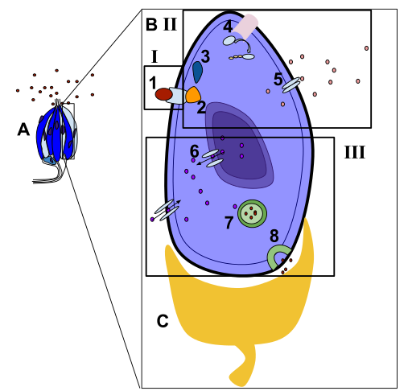
Bitter taste signal transduction
Taste bud
Taste cell
I. Reception of a molecule.
Bitter chemical binds to G Protein-coupled receptors.
II. Transduction pathway
2. Gustducin, a second messenger, is activated.
3. Phosphodiesterase, an enzyme, is then activated.
4. Cyclic nucleotide, cNMP, is used, lowering the concentration
5. Channels such as the K+, potassium, channels, close.
III. Response of the taste cell.
6. Increased levels of Ca+.
7. Neurotransmitters activated.
8. Signal is sent to the neuron.
Hldavis4 & Template:Purves, Dale. Taste Receptors and the Transduction of Taste Signals. U.S. National Library of Medicine, n.d. Web. May-June 2015.

Slide 10
Bitter taste signal transduction
Taste bud
Taste cell
I. Reception of a molecule.
Bitter chemical binds to G Protein-coupled receptors.
II. Transduction pathway
2. Gustducin, a second messenger, is activated.
3. Phosphodiesterase, an enzyme, is then activated.
4. Cyclic nucleotide, cNMP, is used, lowering the concentration
5. Channels such as the K+, potassium, channels, close.
III. Response of the taste cell.
6. Increased levels of Ca+.
7. Neurotransmitters activated.
8. Signal is sent to the neuron.
Hldavis4 & Template:Purves, Dale. Taste Receptors and the Transduction of Taste Signals. U.S. National Library of Medicine, n.d. Web. May-June 2015.

Slide 11
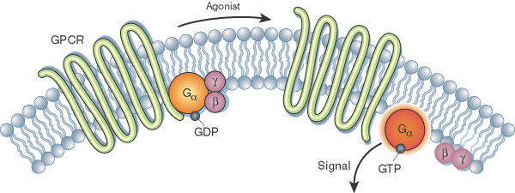
I ♥ G-Protein Coupled Receptors
Largest and most diverse group of membrane receptors in eukaryotes
Wide array of functions in the human body
Targets for 1/3 to 1/2 of all marketed drugs
Well-studied signaling cascade

Slide 12
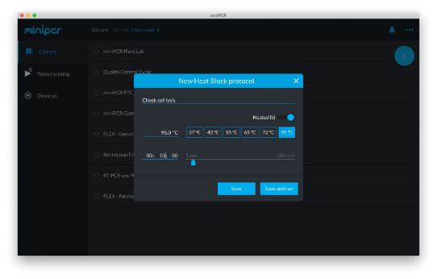
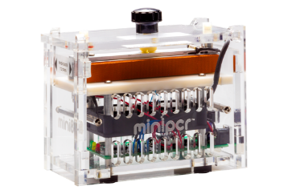
Easy DNA extraction:95ºC, 10 min
DNA extraction
No need for a separate heat block or water bath
Notes:
10 minutes at 95°C
Water baths are expensive…many schools do not have these and therefore attempt to maintain temps with ‘home made’ hot water baths – hard to keep 2 very different temp baths going and it is not super reliable as the temp does drop quickly

Slide 13
2 alleles, 3 SNPs (single nucleotide polymorphism)
aggcagCcactgagc
tccgtcGgtgactcg
tcctgtgCtgccttc
aggacacGacggaag
gcagccGtcctgatc
cgtcggCaggactag
Taster
aggcagGcactgagc
tccgtcCgtgactcg
tcctgtgTtgccttc
aggacacAacggaag
gcagccAtcctgatc
cgtcggTaggactag
Non-taster

Slide 14
2 alleles. 3 SNPs.
aggcagCcactgagc
tccgtcGgtgactcg
tcctgtgCtgccttc
aggacacGacggaag
gcagccGtcctgatc
cgtcggCaggactag
aggcagCcacugagc
uccugugCugccuuc
gcagccGuccugauc
Taster
aggcagGcactgagc
tccgtcCgtgactcg
tcctgtgTtgccttc
aggacacAacggaag
gcagccAtcctgatc
cgtcggTaggactag
aggcagGcacugagc
uccugugUugccuuc
gcagccAuccugauc
Non-taster

Slide 15
2 alleles. 3 SNPs.
aggcagCcactgagc
tccgtcGgtgactcg
tcctgtgCtgccttc
aggacacGacggaag
gcagccGtcctgatc
cgtcggCaggactag
aggcagCcacugagc
uccugugCugccuuc
gcagccGuccugauc
R-Q-P-L-S
S-C-A-A-F
A-A-V-L-I
Taster
aggcagGcactgagc
tccgtcCgtgactcg
tcctgtgTtgccttc
aggacacAacggaag
gcagccAtcctgatc
cgtcggTaggactag
aggcagGcacugagc
uccugugUugccuuc
gcagccAuccugauc
R-Q-A-L-S
S-C-V-A-F
A-A-I-L-I
Non-taster

Slide 16
2 alleles. 3 SNPs.
aggcagCcactgagc
tccgtcGgtgactcg
tcctgtgCtgccttc
aggacacGacggaag
gcagccGtcctgatc
cgtcggCaggactag
aggcagCcacugagc
uccugugCugccuuc
gcagccGuccugauc
R-Q-P-L-S
S-C-A-A-F
A-A-V-L-I
Taster
PAV
aggcagGcactgagc
tccgtcCgtgactcg
tcctgtgTtgccttc
aggacacAacggaag
gcagccAtcctgatc
cgtcggTaggactag
aggcagGcacugagc
uccugugUugccuuc
gcagccAuccugauc
R-Q-A-L-S
S-C-V-A-F
A-A-I-L-I
Non-taster
AVI

Slide 17

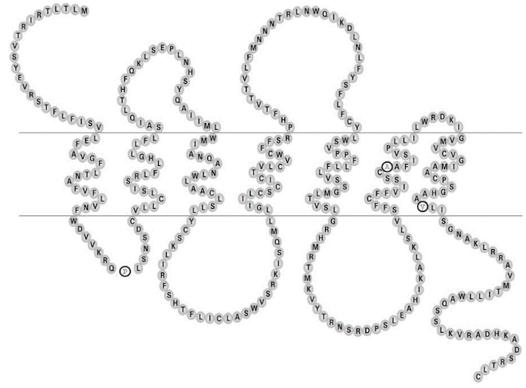
PAV and AVI on the protein
PAV – taster
AVI – non-taster
Note where changes are in the protein.
Do you expect that the binding is affected or the signaling?
Outside of cell
A
Cell membrane
V
V
I
Inside of cell
P
A
Adapted from Kim et al. J. Dent Res (2004)

Slide 18
Taster allele is dominant
TAS2R38 is located on chromosome 7
Alleles
T – taster
t – non-taster
Genotypes
TT – taster
Tt – taster
tt – non-taster
T
T
T
T
t
t
t
t

Slide 19
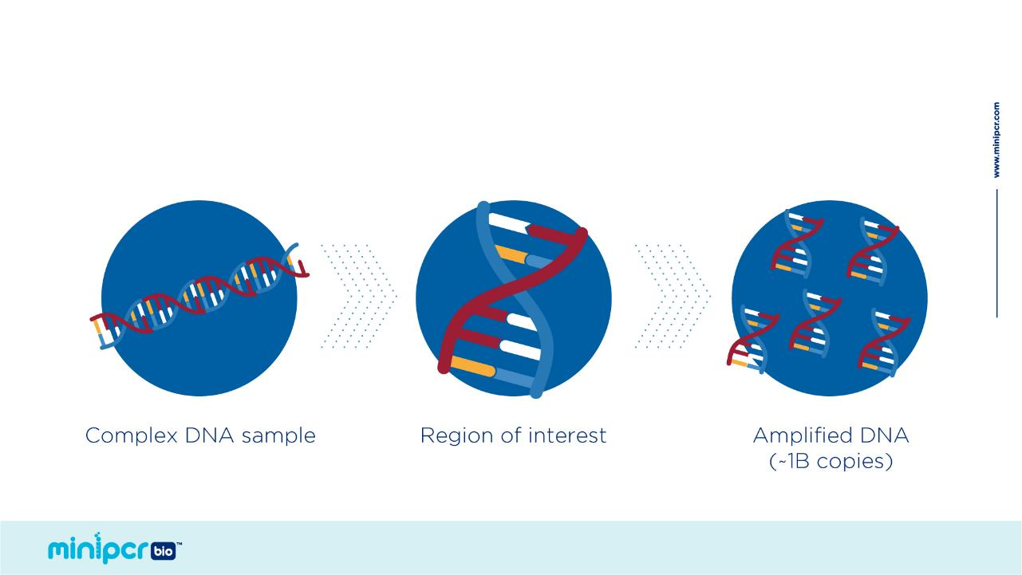
The Polymerase Chain Reaction
Find and replicate a specific DNA target

Slide 20
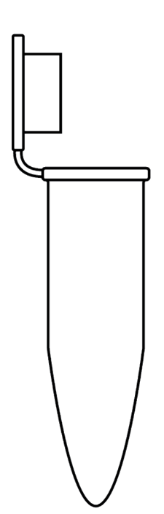
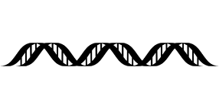
What goes in a reaction
Template DNA to be amplified
Pair of DNA primers
DNA polymerase
dNTPs
Buffer to maintain pH and provide Mg²⁺
PCR Master Mix
FWD primer
G
REV primer
T
A
C
T
G
G
Taq
T
C
G
C
G
T
A
C
A
C
A
A
A
T
G
A
G
T
C
G
C

Slide 21
What goes in a reaction
Template DNA 3 µl
Pair of DNA primers 12.5 µl
PCR Master mix 12.5 µl
FWD primer
G
REV primer
T
A
C
T
G
G
Taq
T
C
G
C
G
T
A
C
A
C
A
A
A
T
G
A
G
T
C
G
C

Slide 22
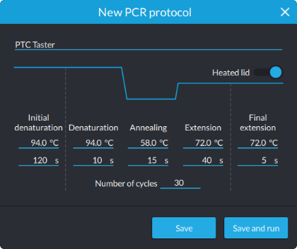
PCR protocol
Initial Denaturation 94°C 120 sec
Denaturation 94°C 10 sec
Annealing 58°C 15 sec
Extension 72°C 40 sec
Number of Cycles 30
Final Extension 72°C 5 sec

Slide 23




PCR: 3 steps to copy DNA
1) 94°C
Denaturation
2) 50-65 °C
Annealing
Primer 2
Primer 1
3) 72 °C
Extension
Taq polymerase
dNTPs

Slide 24
Exponential Amplification

Slide 25
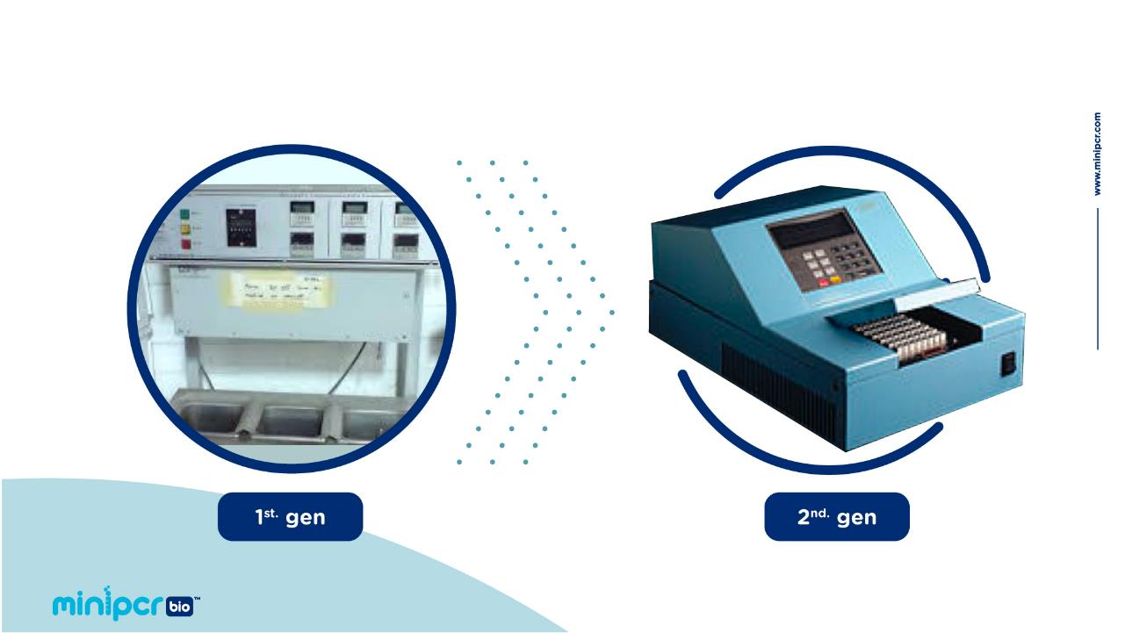
Thermal Cyclers
© 2019 by Amplyus LLC

Slide 26
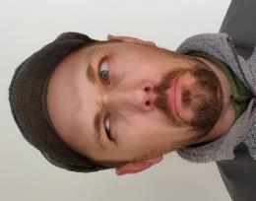


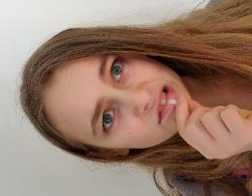
What do we already know about genotypes?
T_
T_
T_
T_
Dad:
Mom:
D1:
D2:

Slide 27

Restriction enzymes
Recognize specific DNA sequences and cut the DNA
5’…GAATTC…3’
3’…CTTAAG…5’
5’…GCNGC…3’
3’…CGNCG…5’
EcoRI
Fnu4HI
tgtggc
acaccgt
agcctctg
cggagac

Slide 28
PCR-RFLP
5’…GCNGC…3’
3’…CGNCG…5’
Fnu4HI
Restriction fragment length polymorphism
Taster allele - SNP785
tgtgC
acacGa
tgcctt
cggaa
Non-taster allele – SNP785
tgtgTtgcctt
acacAacggaa

Slide 29
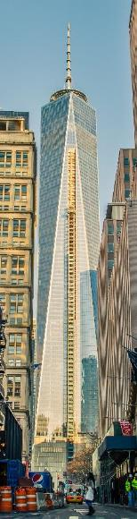
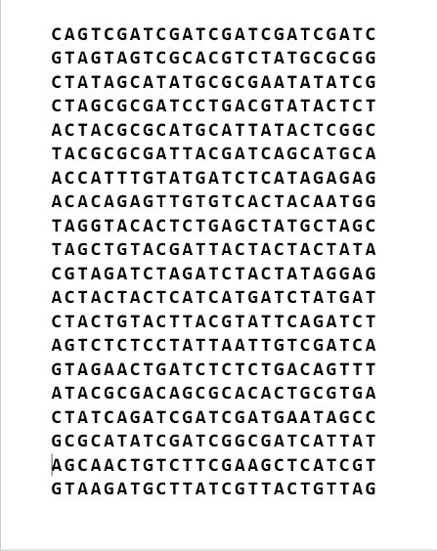
How do we find our RFLP?
Imagine that instead of written in DNA, genetic information were written out on paper -500 nucleotides per page.
Using this analogy, the human genome would be a stack of paper over 1/3 of a mile tall - a little taller than the spire on One World Trade Center.
The TAS2R38 gene is 2 pages long.

Slide 30
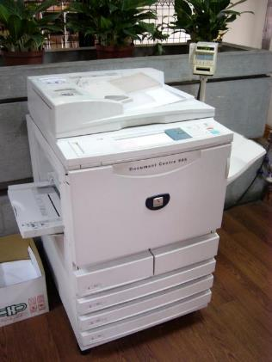
Power of PCR
We end up with a stack of paper 63 miles high!
https://en.wikipedia.org/wiki/Photocopier

Slide 31
From phenotype to genotype in two class periods
DNA extraction
PCR
Restriction digest
Gel electrophoresis
First class (45 min)
Second class (45 min)

Slide 32
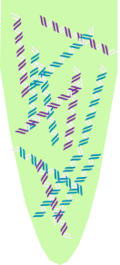

Restriction Digest
In a new tube add:
14 µl PCR reaction
Now contains billions of short fragments (250 bp) that come from the PAV allele, the AVI allele or a mixture of both.
1 µl Fnu4HI

Slide 33
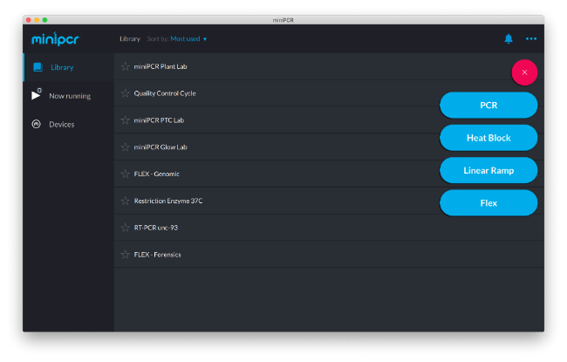
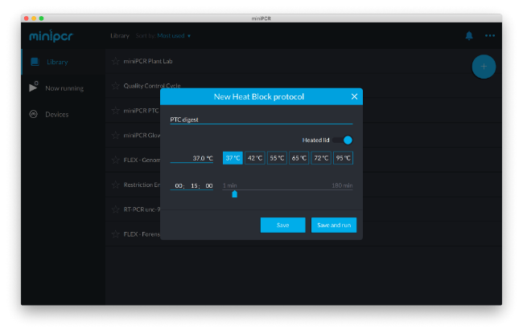
Incubate 15 minutes at 37°C

Slide 34
RFLP
5’…GCNGC…3’
3’…CGNCG…5’
Fnu4HI
Restriction fragment length polymorphism
Taster allele - snp785
tgtgC
acacGa
tgcctt
cggaa
Non-taster allele – snp785
tgtgTtgcctt
acacAacggaa

Slide 35
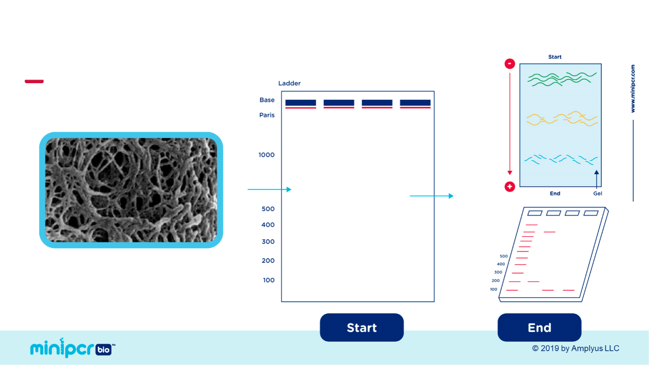
Agarose gel electrophoresis

Slide 36
Larger molecules migrate more slowly
+

Slide 37
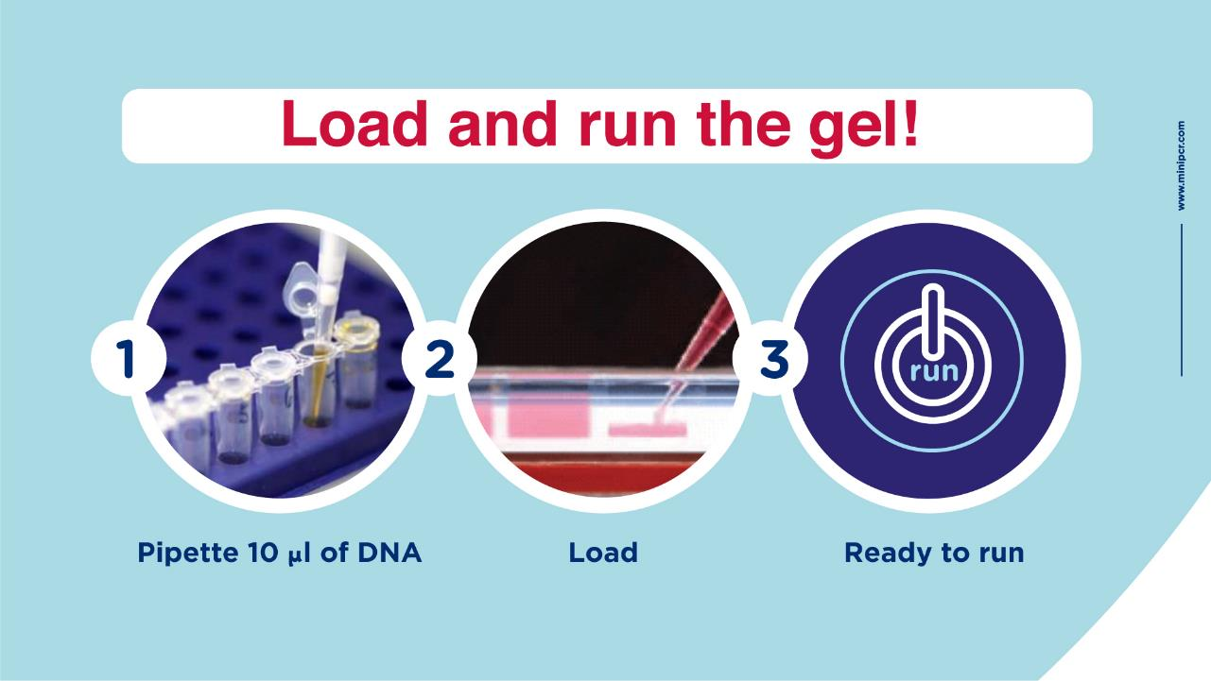
© 2019 by Amplyus LLC

Slide 38

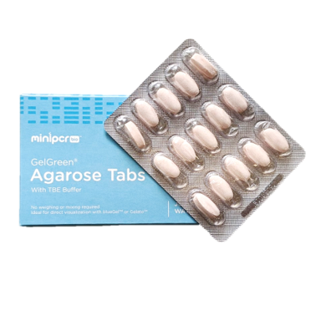
GelGreen® Agarose Tabs
Add water. Melt. Pour.
Pre-weighed agarose tabs contain:
Agarose
Buffer
DNA stain
One tab makes one 2% agarose gel

Slide 39
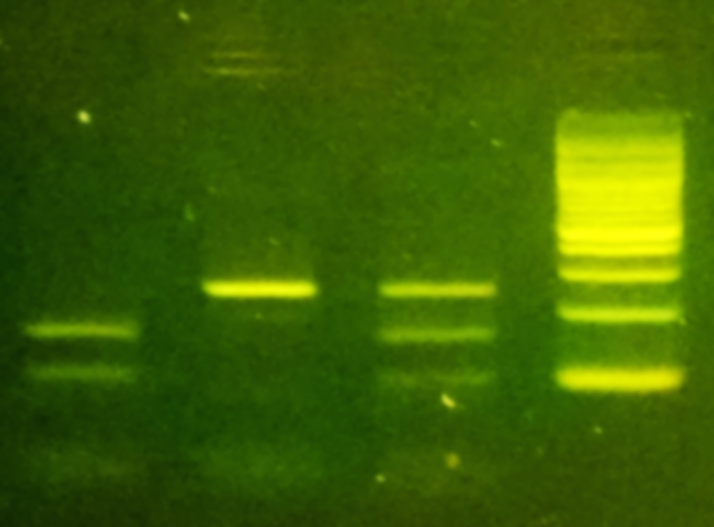
Possible Results
Ladder
A
B
C
Fnu4HI cuts the “taster” allele
A – ?
B – ?
C – ?
Base Pairs
1,000
500
400
300
200
100
Notes:
What are our results?
Alan Torte’s car – 800 BP fragment.
Brenda Biscottis’s car – 400 bp Fragment
What does this mean? We need to compare to controls
Healthy Control- 800 bp
Disease Control – 400 bp
Hair from Brenda Biscotti’s matched the deletion mutation. This is consistent with Missy Baker

Slide 40

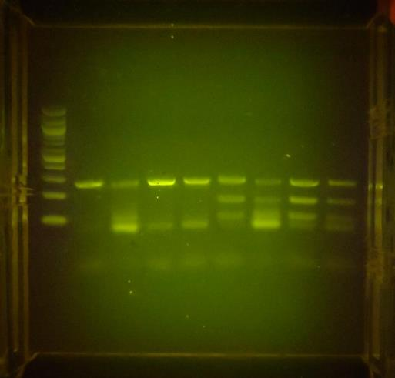




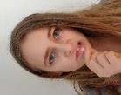


Results!
 | T | t
T | TT | Tt
t | Tt | tt

Slide 41
Full picture of genotype to phenotype
TRANSLATION
AAAAAA
TRANSCRIPTION
SIGNAL TRANSDUCTION
‘taster’ mRNA
‘non-taster’ mRNA
‘taster’ protein
‘non-taster’ protein
genotype
phenotype

Slide 42
Remember genetics is messy!
We use PTC because it is simple.
But even this test does not explain all the variation in PTC tasting.
TAS2R38 is the only known taste receptor that works this way.
Actually 8 different PTC tasting alleles!

Slide 43
Questions
Companies like 23andMe will give you your PTC genotype. Is this how they test it?
How long does the lab take?
Does this relate to supertasting?
Is there any way to replicate this without PTC paper?

Slide 44
Introductory to advanced
Introductory
Genotype to phenotype
Predict your ability to taste using a DNA test!
Advanced
Connect a nucleotide change to an amino acid change to a physiological response.
Signal transduction lab

Slide 45
Extensions
Calculate Hardy-Weinberg for your class data.
Investigate population differences in relation to human evolution.
Genetic drift or balancing selection?
Miraculin.

Slide 46
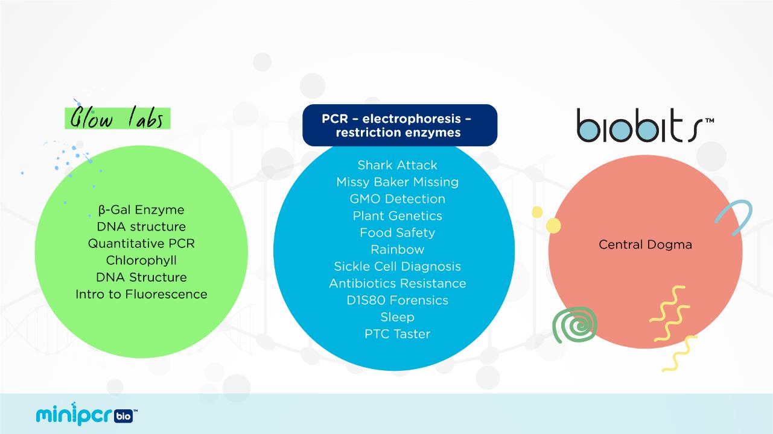
miniPCR Learning Labs

Slide 47
@miniPCR
@BisforBruce
fb.com/minPCR
@miniPCR
© 2019 by Amplyus LLC

